Slide 1


Slide 2
What is Studybook?

Slide 3
Features
Educational tool to help students
Login page
Create an account
Choose your classes
Networking
Organize a study group!

Slide 4
Code Overview

Slide 5
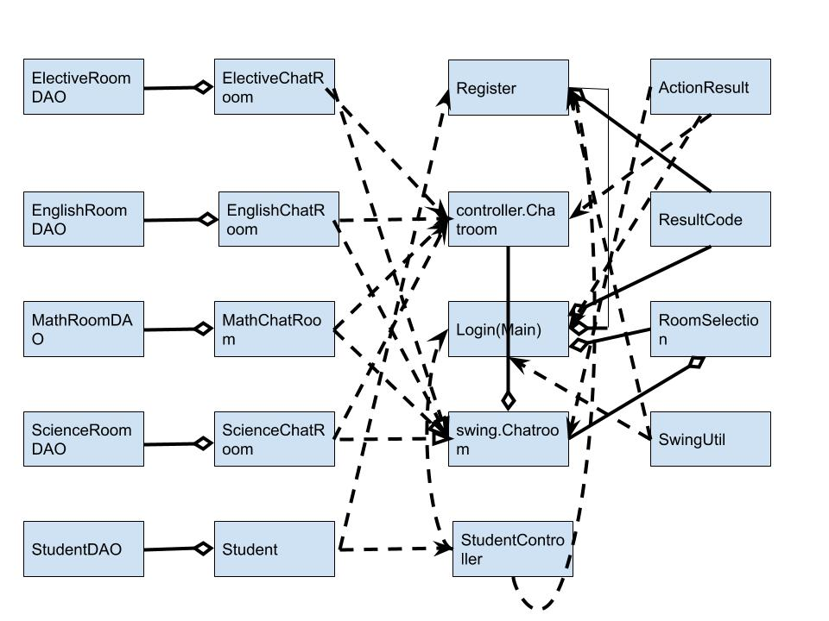
UML

Slide 6
Code Overview
Design Decisions
Login Page
Registering
How to connect with others?
Challenges
Storing information
Chatroom

Slide 7
Instructions

Slide 8
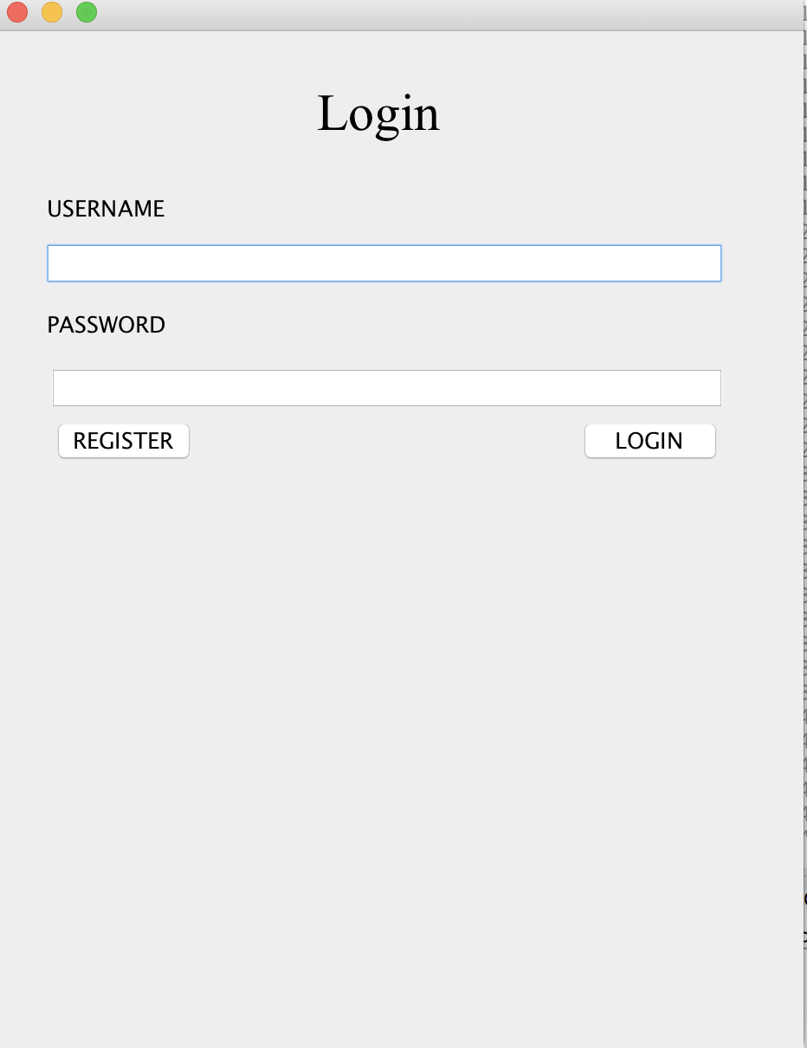
How to use:
Username/Password
Click “Register” to create an account
Fill in info
Use “login” to access an existing account
Choose classes to use!

Slide 9
Buggy Stuff:
Nonexistent user
Chat inputs

Slide 10

Next Steps
Study Group Improvements
More simple way to organize a group
Improved Interface
Move visually appealing
Improved Usability
Use “return/enter” button instead of clicking

Slide 11
MOBILE PROJECT
Show and explain your web, app or software projects using these gadget templates.
Place your screenshot here

